Slide 1
EXPLAIN
EXPLAIN (ANALYZE, BUFFERS)
EXPLAIN (ANALYZE, BUFFERS)
SELECT * FROM orders o
SELECT * FROM orders o
Keyword in PostgreSQL
JOIN customers c ON ...
JOIN customers c ON ...
WHERE o.status = 'pending';
WHERE o.status = 'pending';
Why you should know about
Query Execution Plans
PostgreSQL Performance Engineering

Slide 2
What is EXPLAIN ANALYZE?
EXPLAIN only
EXPLAIN ANALYZE ✓ Use This
• Shows the planner's INTENDED plan
• Actually EXECUTES the query
• Does NOT run the query
• Reports real timing per node
• Safe to use on production
• Shows actual vs estimated rows
• Shows estimated costs, rows, width
• Reveals buffer (I/O) usage with BUFFERS
• No actual timing or real row counts
• Exposes sort spills, loop counts & more
EXPLAIN (ANALYZE, BUFFERS, FORMAT TEXT) SELECT ...

Slide 3
Reading the Output
Seq Scan on orders (cost=0.00..4820.00 rows=1 width=120)
(actual time=0.031..45.231 rows=1 loops=1)
Filter: (customer_id = 42)
Rows Removed by Filter: 99999
cost=0.00..4820.00
actual time=0.031..45.231
rows=1
Planner estimate (startup..total). NOT milliseconds — arbitrary units.
Real wall-clock ms. This is what actually took time.
Estimated rows (planner). Compare to actual to spot bad estimates.
actual rows=1
loops=1
Rows Removed by Filter
Real rows returned. Mismatch with estimated = plan quality issue.
Times this node ran. Multiply time × loops for true total cost.
Rows scanned but discarded. High number = missing index.

Slide 4
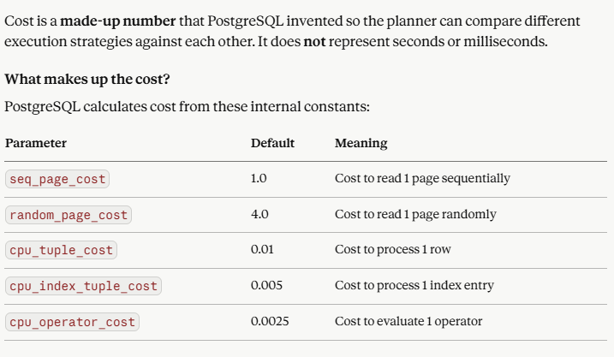
Reading the Output

Slide 5
Common Node Types
Seq Scan
⚠ Watch Out
Index Scan
✓ Ideal
Bitmap Heap Scan
✓ Good
Reads entire table row by row. Fine for small tables. Bad for large tables with selective WHERE clauses.
Uses a B-tree index to jump to matching rows. Fast for selective queries returning few rows.
Collects page locations via index (Bitmap Index Scan), then fetches in physical order. Reduces random I/O.
→ Add an index on the filtered column
→ Already optimal — keep it
→ Good for medium selectivity
Nested Loop
⚠ Check loops
Hash Join
✓ Good
Sort
⚠ Watch Disk
For each outer row, scans the inner side. Deadly with high outer row counts — multiply time × loops.
Builds a hash table from the smaller side, probes with the larger. Efficient for large unsorted datasets.
Sorts rows. If 'Sort Method: external merge Disk' appears, it spilled to disk — work_mem is too low.
→ Ensure inner index exists; consider Hash Join
→ Watch for hash batches > 1 (disk spill)
→ SET work_mem = higher value; or add index

Slide 6
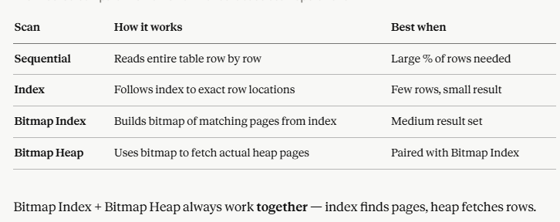
Common Node Types

Slide 7
Common Node Types

Slide 8
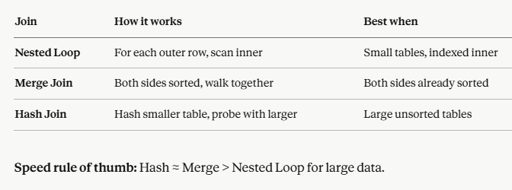
Common Node Types

Slide 9
🚨 5 Red Flags in EXPLAIN ANALYZE
01
Estimate ≠ Actual Rows (Large Gap)
Planner picks wrong join/strategy. Run ANALYZE to refresh table statistics.
rows=1 → actual rows=85,000
Fix: ANALYZE table_name;
02
"Rows Removed by Filter" is Huge
Full table scanned to find almost nothing. Classic missing-index symptom.
Rows Removed by Filter: 4,999,999
Fix: CREATE INDEX ON table(column);
03
High loops on Inner Node
0.8ms × 10,000 = 8 seconds for that node alone. Classic N+1 in disguise.
Index Scan ... (actual time=0.8 rows=1 loops=10000)
Fix: Rewrite as JOIN or add covering index
04
Sort Spilling to Disk
Sort didn't fit in work_mem. Disk I/O is orders of magnitude slower.
Sort Method: external merge Disk: 32768kB
Fix: SET work_mem = '256MB';
05
High Buffer Reads (Not Cached)
Thousands of disk reads vs. cache hits. Data not in shared_buffers — heavy I/O.
Buffers: shared hit=10 read=12000
Fix: Add index, or increase shared_buffers

